Slide 1
Introduction Information Retrieval
Fatemeh Azimzadeh

Slide 2
Grading
Project 2
Final Exam 14
Presentation 2
Assignment 2

Slide 3
Books
(Manning et al., 2008)
Christopher D. Manning, Prabhakar Raghavan, and Hinrich Schütze. Introduction to Information Retrieval. Cambridge University Press, 2008.
(Belew, 2000)
Richard K. Belew. Finding Out About: A Cognitive Perspective on Search Engine Technology and the WWW. Cambridge University Press, 2000.
(Baeza-Yates and Ribeiro-Neto, 1999)
Ricardo Baeza-Yates and Berthier Ribeiro-Neto. Modern Information Retrieval. Addison-Wesley, 1999.
(van Rijsbergen, 1979)
Cornelis Joost van Rijsbergen. Information Retrieval. Butterworths, second edition, 1979.

Slide 4
What is IR?
Information retrieval (IR):
An area of study that is related to search and retrieval of documents from the Internet or database archived [38].
Enormous type of data in digital form has necessitated serious interest in methods for assisting the user in locating data of interest.

Slide 5
What is IR?
Zhu and Guach [33] classified information retrieval into two broad categories namely the centralized and distributed information retrieval systems.
In a centralized information retrieval system, all the documents are kept at a single site as a local site which also answers to all the queries.
In a distributed information retrieval systems, users are allowed to access documents where collections are distributed across multiple remote site system.

Slide 6
What is IR?
IR: Part of computer science which studies the retrieval of information (not data) from a collection of written documents.
The retrieved documents aim at satisfying a user information need usually expressed in natural language.

Slide 7
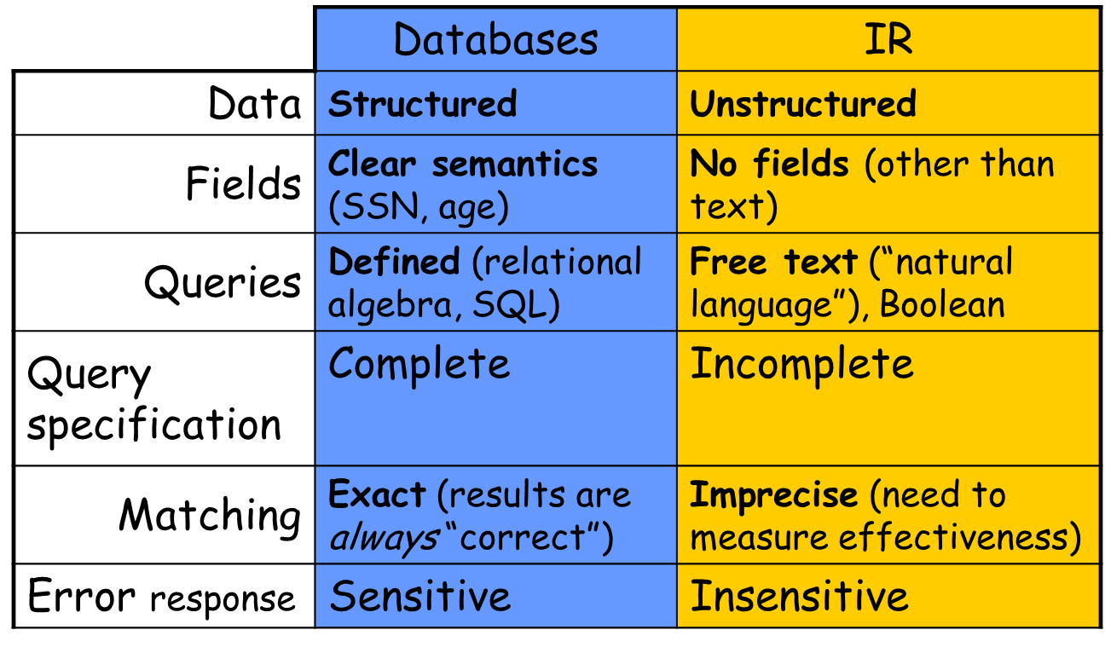
Information Retrieval vs Data Retrieval

Slide 8
What is IR?
Narrow-sense:
IR= Search Engine Technologies (IR=Google, library info system)
IR= Text matching/classification
Broad-sense:
IR = Text Information Management:
General problem: how to manage text information?
How to find useful information? (retrieval)
Example: Google
How to organize information? (text classification)
Example: Automatically assign emails to different folders
How to discover knowledge from text? (text mining)
Example: Discover correlation of events

Slide 9
Web Search
Very similar to information retrieval
• Main differences:
Links between Web pages can be exploited
Collecting, storing, and updating documents is more difficult
Usually, the number of users is very large
Spam is a problem

Slide 10
Search Engine
Due to the massive growth of the WWW, “search engines” applications have been created as fast and efficient systems in finding electronic information.
Search engines are designed for general or special purposes.
A web search engine typically consists of two fundamental components:
Web crawlers: which serve to download and parse content in the WWW.
Data miners: that extract keywords from pages, rank document importance, and answer the user queries [40].

Slide 11
crawler
A web crawler (also known as a web spider or web robot) is a program or automated script that browses the Internet seeking web pages to process.
Crawlers are given a starting set of web pages (seed pages) as their input to extract outgoing links appearing in the seed pages.
Crawlers determine what links to visit next based on certain set criteria.
Web pages pointed by these links are downloaded and those satisfying certain relevance criteria are stored in a central repository.
The crawler will periodically return to the sites to check for any information that has changed.

Slide 12
Web Crawling

Slide 13
Web Crawling Issues
Coverage
Google, the biggest search engine, covers only 70% of web content
We must focus on high quality pages
Freshness
Keep the copy in synchronize with the source pages
Politeness
Do it without disrupting the web and obeying the webmasters constrains

Slide 14
Data miners
A data miner in a web search engine typically consists of a document indexer, a document ranker, and results presentation interface.
The indexers analyze the information contained within corpus documents into a format which is amenable to quick access by the query processor.
Typically, this involves extracting document features by breaking-down the documents into their constituent terms, extracting statistics relating to term presence within the documents, and calculating any query-independent evidence.

Slide 15
Indexing
Text Operations forms index words (tokens).
Stopword removal
Stemming
Indexing constructs an inverted index of word to document pointers.

Slide 16
Indexing
The indexers analyze the information contained within corpus documents into a format which is amenable to quick access by the query processor.
Typically, this involves extracting document features by breaking-down the documents into their constituent terms.
Extracting statistics relating to term presence within the documents, and calculating any query independent evidence.

Slide 17
An Example of Forward Indexing

Slide 18
An Example of Inverted Indexing

Slide 19
Ranking
Ranking is the process which estimates the quality of a set of results retrieved by a search engine
Ranking is the most important part of a search engine

Slide 20
Ranking Type
Content-based
Classical IR
Connectivity based (web)
Query independent
Query dependent
User-behavior based

Slide 21
Publications/societies
ACM’s SIGIR
Special Interest Group on Information Retrieval
Annual conferences, beginning in 1978
Gerald Salton award, first honoree: Gerald Salton (1983)
TREC
Annual Text Retrieval Conference, beginning in 1992
Sponsored by the U.S. National Institute of Standards and
Technology as well as the U.S. Department of Defense
Today: many different tracks, e.g., blogs, genomics, spam
Provides data sets and test problems

Slide 22
Publications/societies
Applications:
Web, Bioinformatics…
Machine Learning
Data Mining
WWW
Library & Information
Sciences
ISMB
RECOMB, PSB
ICML, NIPS, UAI
Information
Retrieval
ACM SIGKDD
ICML
ASIS
Natural Language
Processing
ACM SIGIR
JCDL
AAAI
HLT
Databases
ACM CIKM, TREC
ACL
Software Engineering
Computer Systems
ACM SIGMOD
COLING, EMNLP, ANLP
VLDB, PODS, ICDE
OSDI
SOSP

